Slide 1


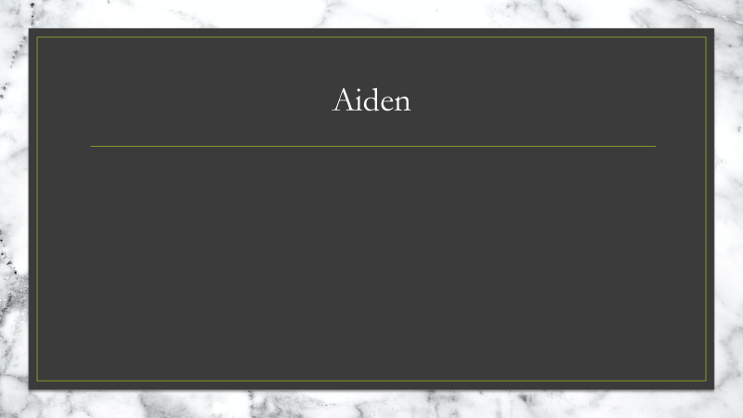


Coffee Mania Art-Bible
Mean Bean Studios
Aiden, Domenic and Tarek

Slide 2
Project overview

Slide 3
Team members and roles

Slide 4
Moodboards
Description of the group take on mood and why its displayed by each artist.

Slide 5

Aiden

Slide 6
Domenic

Slide 7
Tarek

Slide 8
Art style

Slide 9
A justification of the art style

Slide 10
Concept art
Why we have done it the way we have
What are we trying to capture

Slide 11
Aiden

Slide 12
Domenic

Slide 13
Tarek

Slide 14
Color pallets
Each page should contain a small amount about why the colors are chosen and what they will be representing.

Slide 15
Mountains

Slide 16
Desert

Slide 17
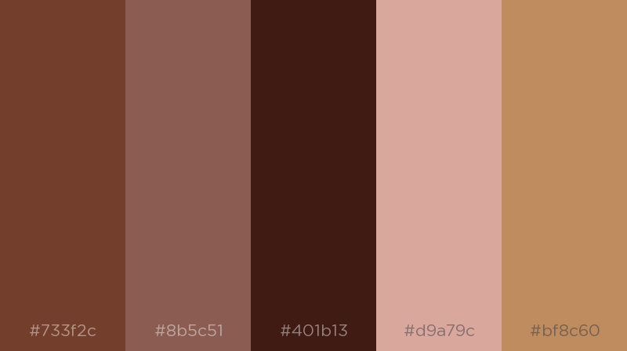
Character

Slide 18



Asset list
Background img-Mountains
Background img-Desert
Foliage-Mountain x2
Foliage-Desert x2
Rock-Mountain x2
Rock-Desert x2
Ground plane-Mountain
Ground plane-Desert
Mountain-Mountain
Hill-Desert
Tree-Mountain
Tree-Desert

Slide 19
Asset list
Bricks-Mountains
Bricks-Desert
Wooden plank x2
---------------------------------------

Slide 20

Asset list Expanded
Asset | Poly count | Textures | Texture size | Description | Notes
Background Mountain | 2 tri | Albedo | 1024x1024 | Image plane of mountains / sky
Background Desert | 2 tri | Albedo | 1024x1024 | Image plane of mountain / sky
Foliage Mountain | 3000 tri | Albedo Specular Alpha Gloss | 1024x1024 | Two types of plants used to populate the ground | Two unique assets to provide better variation
Foliage Desert | 3000 tri | Albedo Specular Alpha Gloss | 1024x1024 | Two type of plants used to populate the ground | Two unique assets to provide better variation

Slide 21
Asset list Expanded
Asset | Poly count | Textures | Texture size | Description | Notes
Rock Mountain | 2500 tri | Albedo Specular Alpha Gloss | 1024x1024 | Two types of rocks used to populate the environment | Two assets which will be used to populate the scene
Rock Desert | 2500 tri | Albedo Specular Alpha Gloss | 1024x1024 | Two types of rocks used to populate the environment | Two assets which will be used to populate the scene
Ground plane Mountain | 2000 tri | Albedo Specular Alpha Gloss | 1024x1024 | A ground plane to cover most of the environment
Ground plane Desert | 2000 tri | Albedo Specular Alpha Gloss | 1024x1024 | A ground plane to cover most of the environment

Slide 22
Asset list Expanded
Asset | Poly count | Textures | Texture size | Description | Notes
Mountain Mountain | 2000 tri | Albedo Specular Alpha Gloss | 512x512 | A mountain used to change the environment | The transition point from mountain to desert
Hill Desert | 2000 tri | Albedo Specular Alpha Gloss | 512x512 | A hill that will have stairs to transition to the mountains | The transition point to the mountains from the desert
Tree Mountain | 2000 tri | Albedo Specular Alpha Gloss | 1024x1024 | Trees that can be used to further populate the scene
Tree Desert | 2000 tri | Albedo Specular Alpha Gloss | 1024x1024 | Trees that can be used to further populate the scene

Slide 23
Asset list Expanded
Asset | Poly count | Textures | Texture size | Description | Notes
Bricks/ruins Mountain | 2000 tri | Albedo Specular Alpha Gloss | 1024x1024 | Small ruins/ bricks to add interest to the environment.
Bricks/ruins Desert | 2000 tri | Albedo Specular Alpha Gloss | 1024x1024 | Small ruins/ bricks to add interest to the environment
Wooden planks | 2000 tri | Albedo Specular Alpha Gloss | 1024x1024 | Wooden planks that can be used with the ruins or to build other structures | Build two types to allow for greater variation.

Slide 24
Art tools
Tools which will be used to create the art for the project will include
Photoshop
Substance painter
Substance designer
Maya
Zbrush

Slide 25
Photoshop
Photoshop will be used to concept and create key outlines or touchups in textures.
Photoshop will also be used to create any 2D assets of detailing that we need
The justification for this software lies in the abilities of the artists and the software's dynamic uses which can be applied effectively to achieve goals.

Slide 26
Maya
Maya will be used to create the models and the final topology for all of the assets.
Maya was chosen again based on the abilities of all the team members, which means each team member should be fully competent with the software resulting in efficient workflow.

Slide 27
Zbrush
Zbrush will be used to create detailing and extra information which will be baked allowing for higher quality assets without needing as much topology per asset.
Zbrush was selected for its compatibility with Maya and Substance which allows for easy baking and quick integration into the pipeline.

Slide 28
Substance Painter
Substance painter will be the main program to texture all assets. Furthermore, it will be used for baking all assets which will be a vital step in the pipeline.

Slide 29
Substance Designer
Given the need for seamless repetitive textures using Substance Designer would be an ideal system to learn to allow effective asset texturing.
The only downside is there is a lack of skill and understanding when it comes to this software amongst the artists.

Slide 30
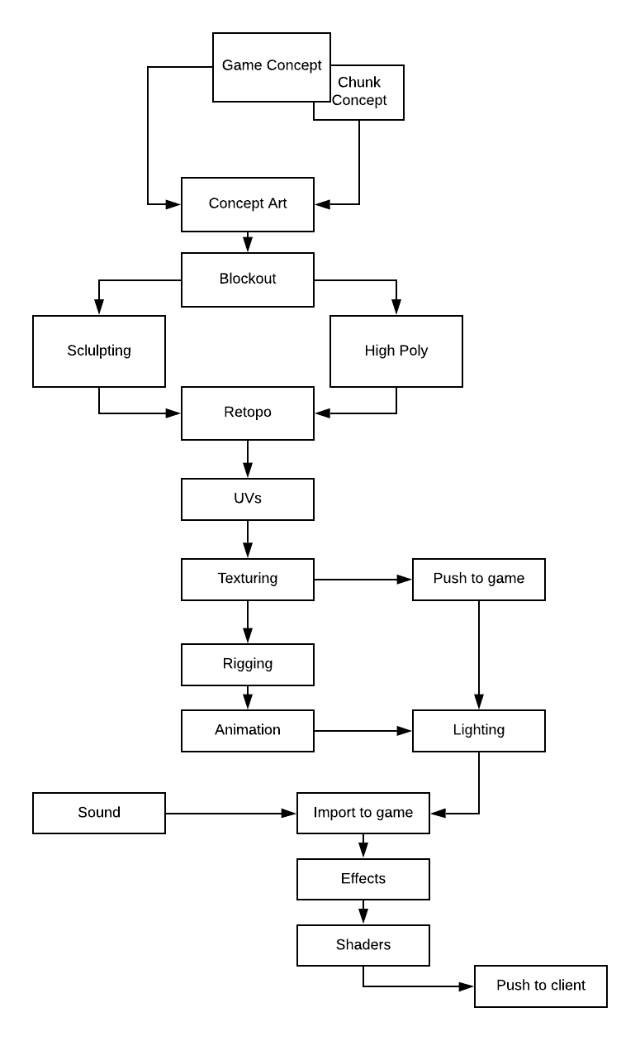
Pipeline Diagram
The movement of game art assets though the pipeline will focus on quality and effective use of time.
The biggest bottleneck and area for concern is the pushing to game, this could be an issue if assets are done incorrectly as it would delay the final push.

Slide 31
Technical Guidelines
Project will be conducted in Unity 2018.2.5f1 for a Windows PC
All assets will be exported as .fbx
Textures will be exported as .png

Slide 32
Naming Conventions
AssetnameAlbedo.png
AssetnameAlpha.png
AssetnameGloss.png
AssetnameSpecular.png
AssetnameEmission.png
Assetname.fbx
AssetnameAnimation.fbx

Slide 33
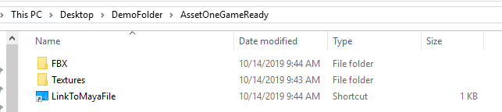
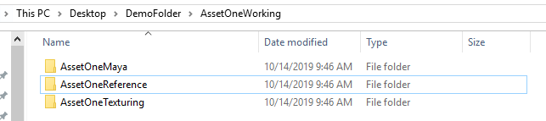
File Format
All files should be in appropriate folders.
Shortcuts should be used to link to other folders if used.
Example:
Environment>Mountains> ConifirTree>ConifirTreeTextures> ConifirTreeAlbedo.png

Slide 34
Limitations and Requirements
All assets should aim to be under 7,000 tris
All textures should be aiming to be under 1k resolution
Assets should be modular
Any environmental asset should be seamless unless a direct reason is given for it to not be.

